Slide 1
CONTENT TO COVER
Introduction to Machine Learning Part 1
What is Machine Learning?
What it does actually or why do we need ML or AI?
Types of Machine Learning algorithms
Overview of some Machine Learning Algorithms
Machine Learning Model Performance Evaluation Metrics

Slide 2

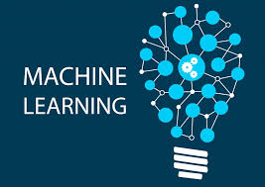
Introduction to Machine Learning Part 1
What is Machine Learning?
Machine Learning is a branch of Artificial Intelligence (AI), which helps in making machines capable of learning from observational data without being explicitly programmed.
“A computer program is said to learn from experience E with respect to some class of tasks T and performance measure P if its performance at tasks in T, as measured by P, improves with experience E.”
Tom Mitchell

Slide 3
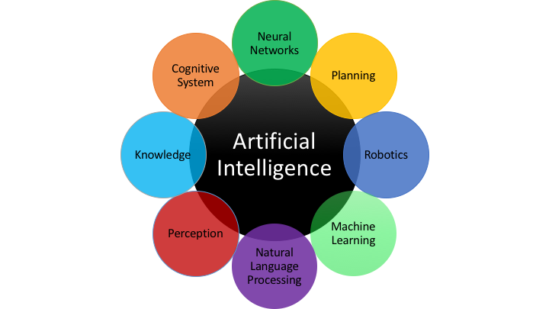
Machine learning is a component of AI !

Slide 4
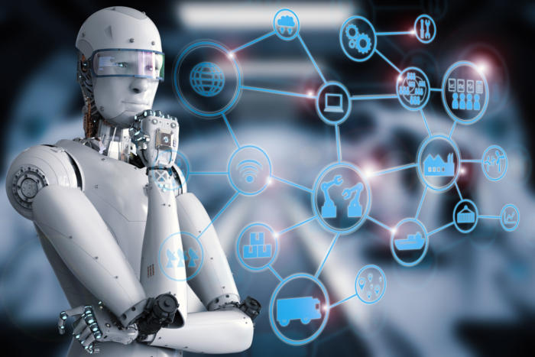
What does it actually do or why do we need ML or AI?
We want to automate certain processes using a computer.
But we’ve been automating tasks since the invention of the computer. This raises the next question.
Why is the classical way of programming a computer not sufficient?
?
?

Slide 5

The Classical Way of Programming Machines
Problem
Rules
Code
Solution
A developer or product manager analyzes the problem and figures out the rules/algorithm. This rules or Algorithm are then translated into programming code that can be run on a computer.
Examples are:
Apps, Games, Online stores, Websites, Accounting Softrwares e.t.c

Slide 6
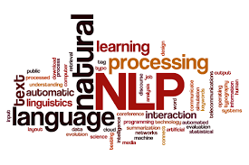
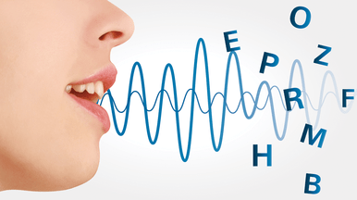

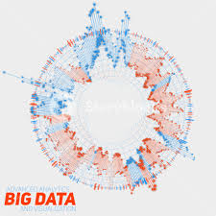
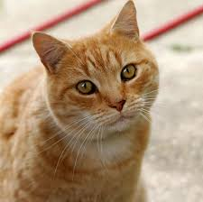
Where The Classical Approach Fails
There is a set of problems where we are not able to identify and explicitly write down these rules. This concerns problems like image and speech recognition, natural language processing, or identifying complex patterns in data.

Slide 7

Why Machine Learning?
Problem
Rules
Code
Solution
We are able to identify objects with our eyes, talk to and understand other people, read and write text, understand languages. e.t.c
But we don’t know how our brain does it, or what rules it follows.
Nature is too complex, too ambiguous, varies a lot, hence cannot be described by a finite set of explicit rules.

Slide 8
RE-DEFINING MACHINE LEARNING
Machine learning is basically an automated approach, where a machine (computer) analyzes data (images, audio, texts, etc.) for certain patterns.
The difference is that the machine figures out the rules on its own, i.e which patterns to look for (usually by analyzing many examples).
The machine learns the rules which would be impossible for a programmer to explicitly write down.

Slide 9

Where should you use Machine Learning?
Not all task requires ML!
Only Use ML when:
When classical approach fails.
When classical approach works but is computational intractable.

Slide 10
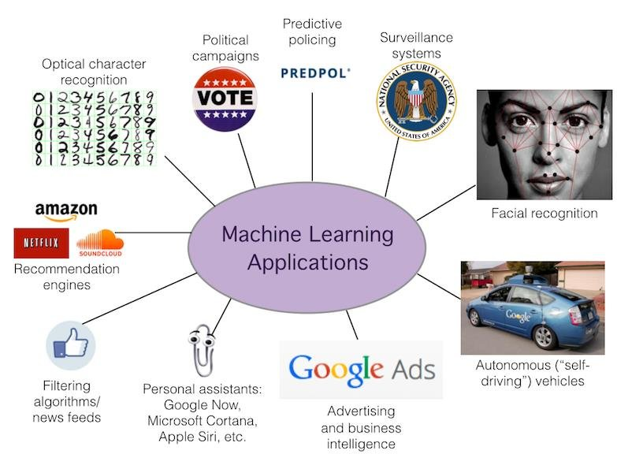
PRODUCTS THAT USE ML

Slide 11
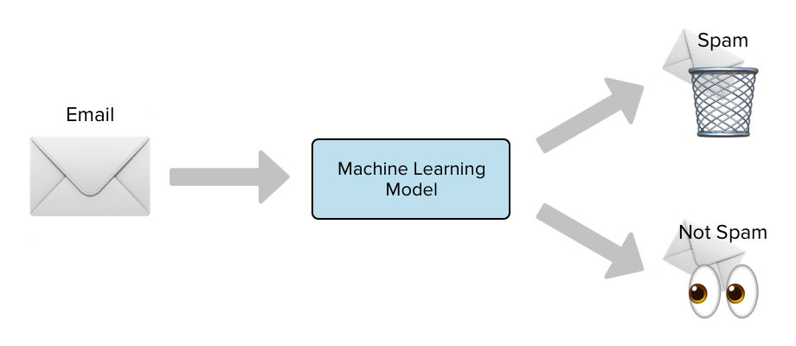
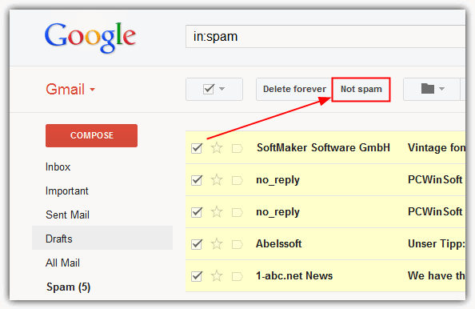
Spam Detection_products that uses ML
When Google Mail detects your spam mail automatically, it is as a result of applying machine learning techniques.

Slide 12

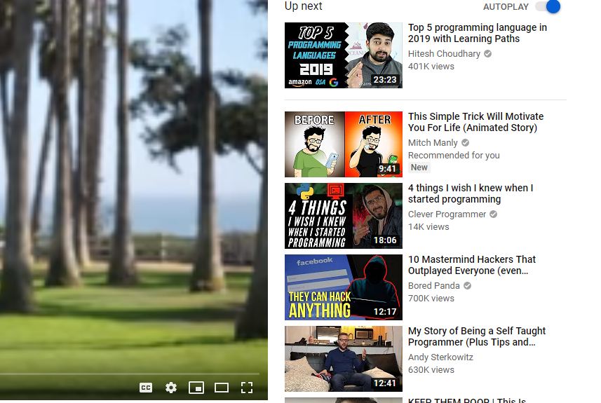
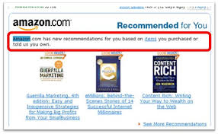
Product Recommendation_products that uses ML
When Netflix suggest movies to you, when Amazon suggest you books, or when YouTube recommend videos to you. It's not magic, its machine learning.

Slide 13
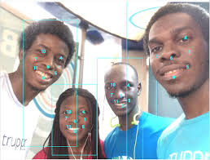
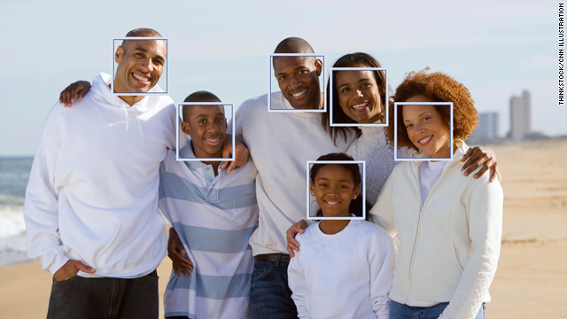
Face Detection_products that uses ML
When Facebook automatically recognizes faces of your friends in a photo, a machine learning process is what's running in the background.

Slide 14
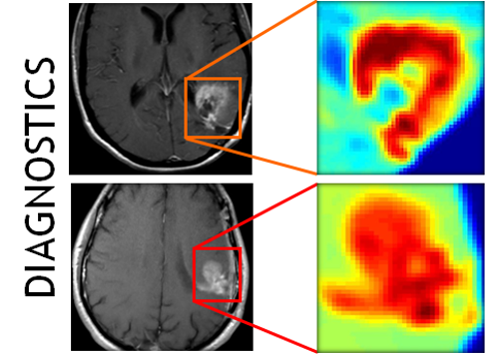

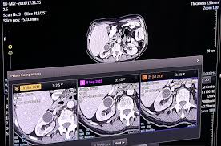
Medical Treatment/Diagnosis_products that uses ML
IBM Watson Genomics
Retina – AI’s fluid intelligence
Babylon Health for Analysis
Careskore
Google Deepmind Health for fast-track medical information
Splice Machine & QIAGEN Clinical Insight (QCI) for precision medicine

Slide 15
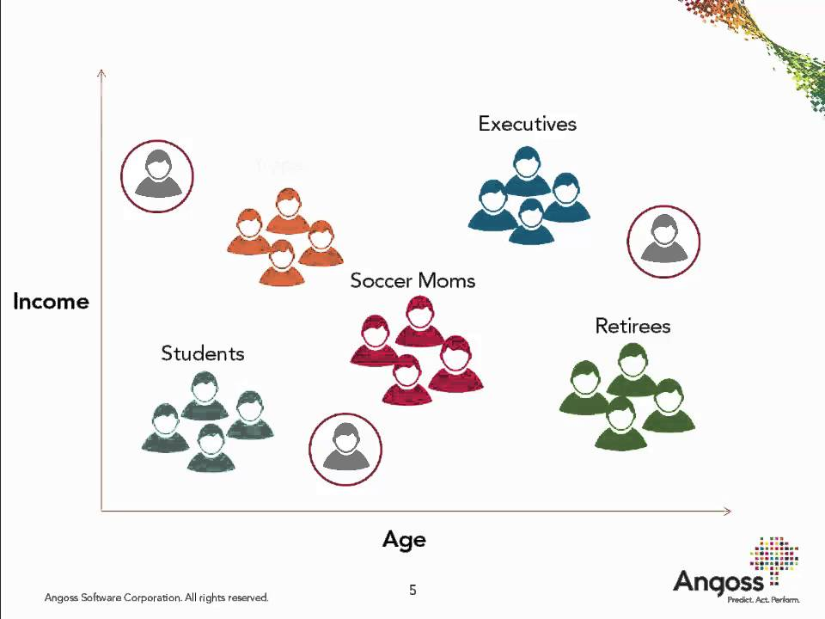
Customer Segmentation_products that uses ML
Using Income and Age data we could cluster/ segment customer into the following categories.
This is called Segmentation.

Slide 16
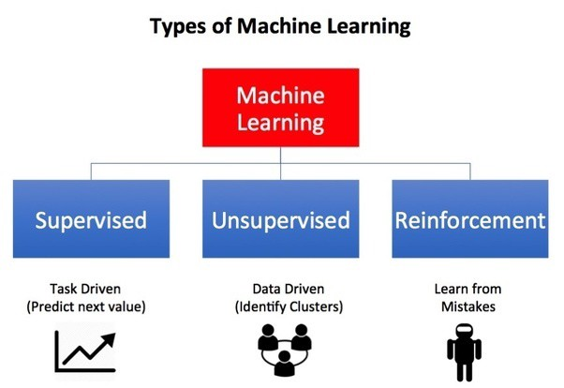
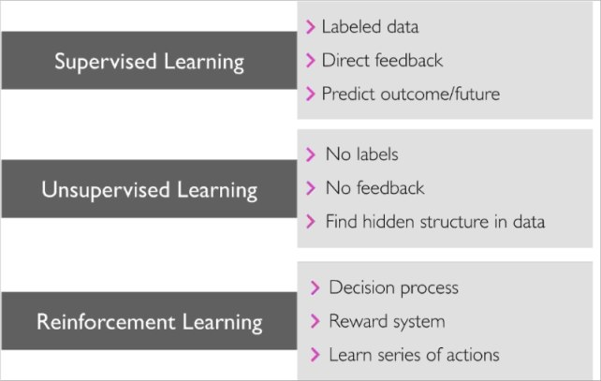
TYPES OF MACHINE LEARNING
Supervised Learning: classification and regressions problems.
Unsupervised Learning : Clustering problems
Reinforcement Learning

Slide 17
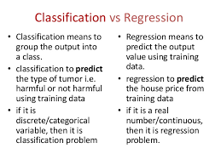
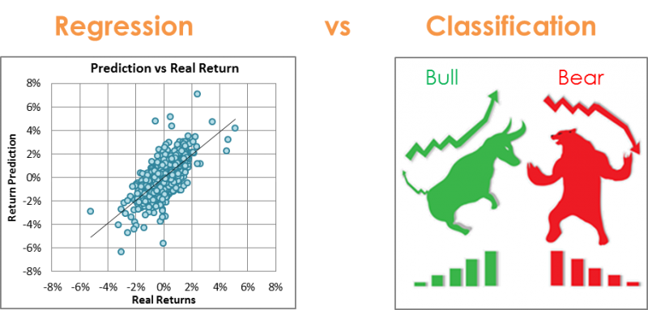
SUPERVISED LEARNING _TYPES OF MACHINE LEARNING
It consists of Classification and Regression Problems.
The target variable is known.

Slide 18
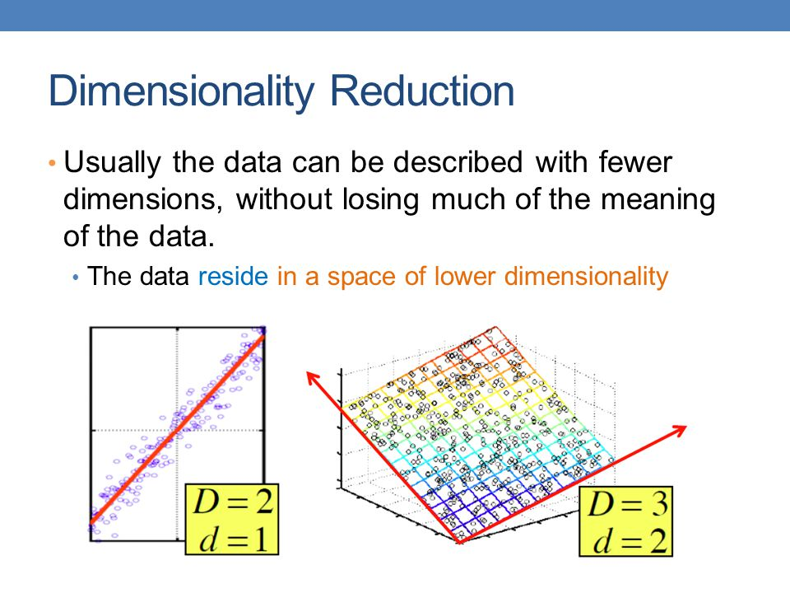
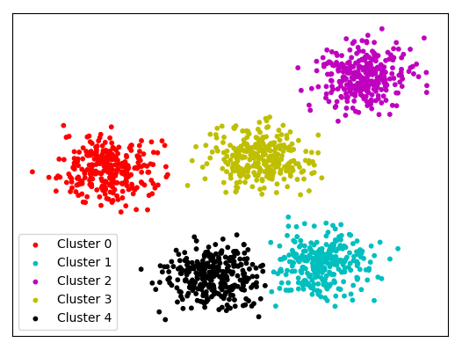
UNSUPERVISED LEARNING _TYPES OF MACHINE LEARNING
It consists of Clustering and Dimension Reduction Problems.
The target variable is unknown.
Dimensionality reduction
Clustering

Slide 19
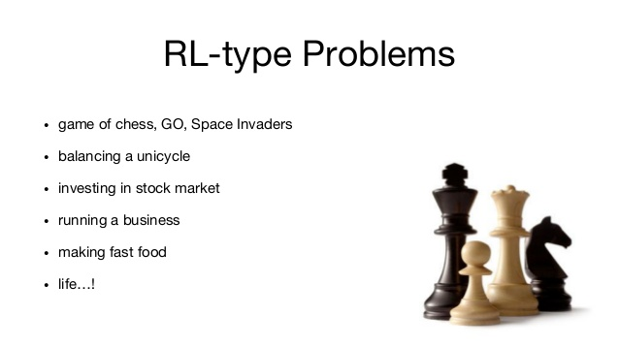
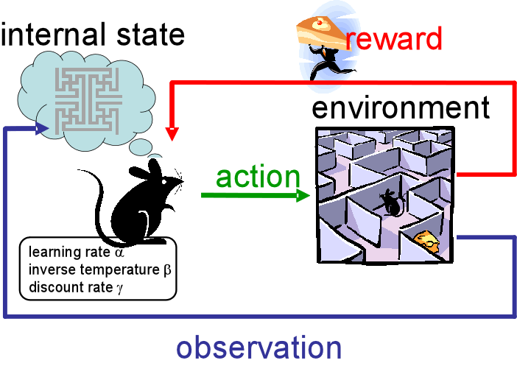
REINFORCEMENT LEARNING _TYPES OF MACHINE LEARNING
Reinforcement learning refers to goal-oriented algorithms, which learn how to attain a complex objective (goal) or maximize along a particular dimension over many steps.

Slide 20

AN OVERVIEW OF SOME MACHINE LEARNING MODELS

Slide 21
THE “NO FREE LUNCH THEOREM”
The “No Free Lunch” theorem states that no one algorithm works best for every problem
Pick an Algorithm based on true problem.
Pick an Algorithm based on the data set.

Slide 22
SOME SUPERVISED LEARNING ALGORITHMS

Slide 23
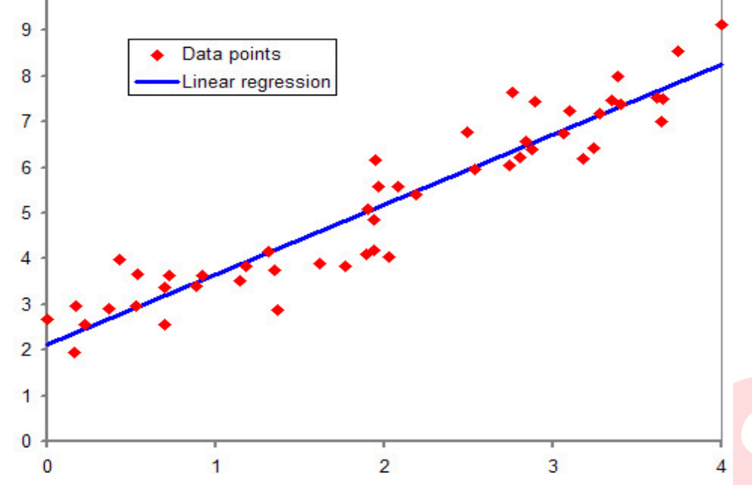
LINEAR REGRESSION
Linear regression simply finds a line that best fits the relationship between the input variables (x) and the output variables (y), by finding specific weightings called coefficients (B).
For example: y= B0 + B1 * x

Slide 24
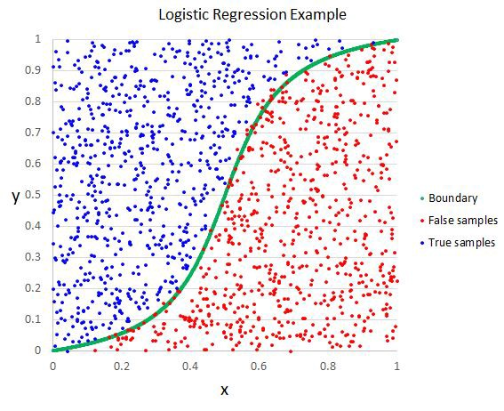
LOGISTIC REGRESSION
It is the go-to method for binary classification problems (problems with two class values)
It separates data into classes.

Slide 25
OTHER POPULAR SUPERVISED LEARNING ALGORITHMS
Decision Trees
Random Forests
Bootstrap Aggregation (Bagging)
XGBoost
LightGBM
CatBoost etc

Slide 26
SOME UNSUPERVISED LEARNING ALGORITHM
K-MEANS
PCA (PRINCIPAL COMPONENT ANALYSIS
Generative Models

Slide 27
EVALUATING MODEL PERFORMANCE
Regression problems
Mean Absolute Error
Mean Squared Error
R-squared error
RMSE (Root Mean Squared Error)
e.t.c
Can all implemented in Scikit-Learn (A python machine learning package)
Classification problems
Accuracy
Classification Report
Confusion Matrix
Can also be implemented in Scikit-Learn (A python machine learning package)

Slide 28
SUMMARY OF DISCUSSION

Slide 29

END OF THE SLIDES Thank you for Listening
Acknowledgements.
Data Science Nigeria (AI – INVASION PROGRAM)
Rising Odegua’s GitHub. (https://github.com/risenW)
Marquis Victor’s GitHub. (https://github.com/marquisvictor)
UNILAG AI+ Club (https://twitter.com/@aiplusunilag)

